Slide 1
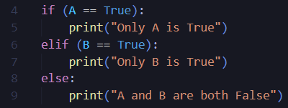
Welcome to Hacknight!
Icebreaker Time!
Spot the bug in this code:

Slide 2

HTML/CSS/Javascript Tutorial
BugSmashers

Slide 3
HTML
HTTP - Hypertext Transfer Protocol
HTML - Hypertext Markup Language
Tells a web browser how to structure a web page

Slide 4
Basics
TAGS
ATTRIBUTES
ELEMENTS

Slide 5
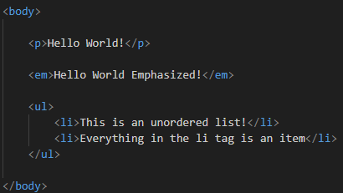
TAGS

Slide 6

ATTRIBUTES

Slide 7
DEMO

Slide 8
CSS - Cascading Style Sheets
NORMAL FORMAT
TWO COLUMNS
GREEN
FLEX BOXES

Slide 9
Basics
SELECTOR
PROPERTIES
VALUE

Slide 10
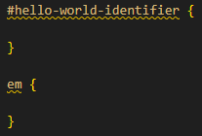
SELECTOR
CHOICES:
HTML element name
# for an id
. for a class

Slide 11
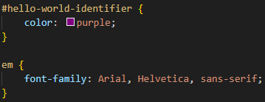
PROPERTIES/VALUES
Properties
Part of element that is being changed
Values
How the elements are changing (by how much)

Slide 12
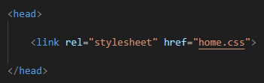
How to Implement CSS into HTML:
rel - relationship between document that is linked and the document you are working in
href - the link to the resource that you are using. Can be a relative link to your directory, or a URL

Slide 13
DEMO

Slide 14
JAVASCRIPT BASICS
With HTML
Functions
Object Oriented Programming
When combined with HTML, Javascript allows the web page to be more interactive with users!!!
Javascript makes usage of functions, which is a block of code that gives an output that can depend on an input
While Javascript does not have classes, it is still considered an object oriented programming language

Slide 15

FUNCTIONS

Slide 16


How to Implement Javascript into HTML:
The code on the left is in the HTML file
The code on the right is a function in the javascript file
The script part is generally implemented in the “head” tag in the HTML file, while the button created is in the “body” tag

Slide 17
DEMO

Slide 18
CREDITS
This is where you give credit to the ones who are part of this project.
Presentation template by Slidesgo
Icons by Flaticon
Infographics by Freepik
Images created by Freepik
Author introduction slide photo created by Freepik
Text & Image slide photo created by Freepik

